Slide 1
USA Emissions

Slide 2
Creating a subset
There are 37 variables in the given dataset, with values for years from 1800 to 2018.
The dataset is clean and doesn’t have any invalid values.
But only 7 variables have values across all the years.
Hence making a subset of those 7 values.

Slide 3
The selected 7 variables are
co2, co2_growth_prct, co2_growth_abs,
co2_per_capita, population,
share_global_co2, cumulative_co2

Slide 4
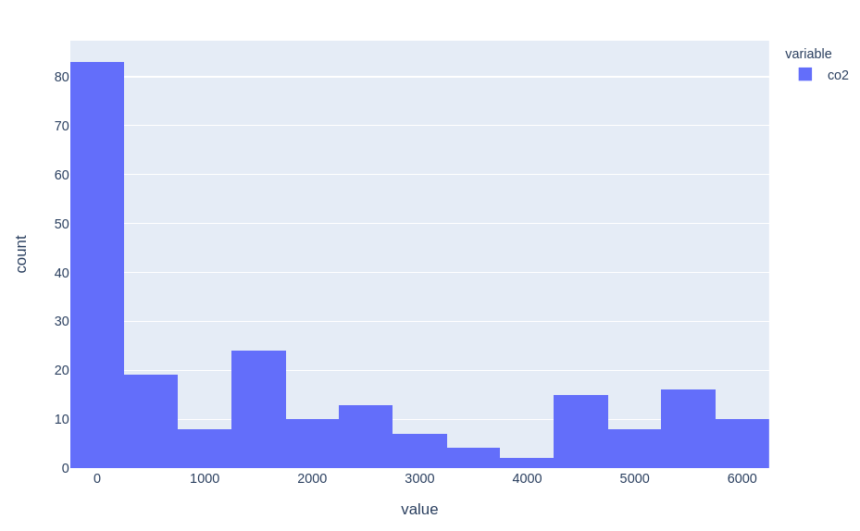
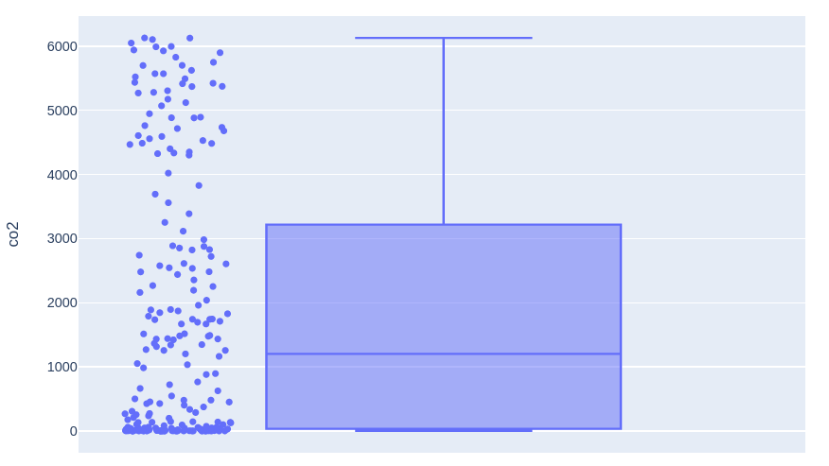
Count of co2 values
83 values in the first bar with range of -250 to 250.
No Outliers

Slide 5
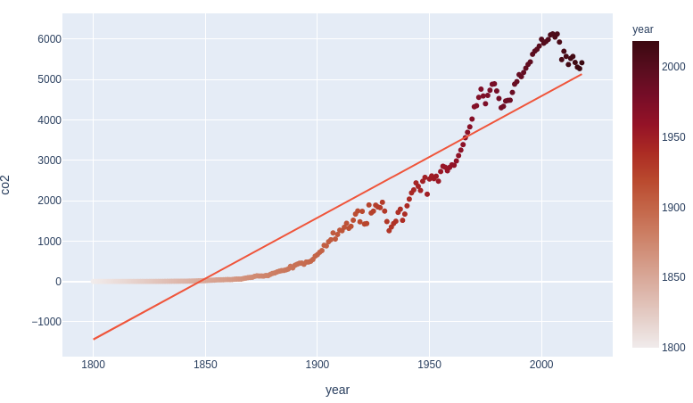
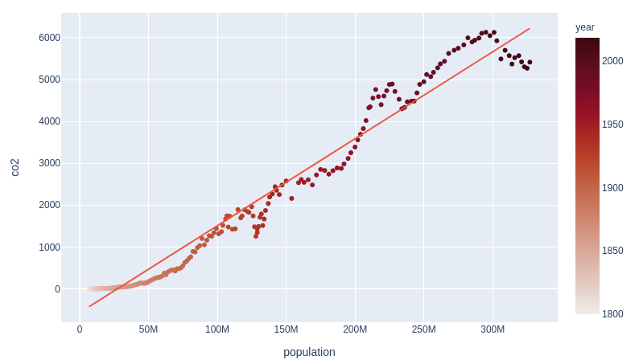
Line chart
CO2 vs Year line chart
with R² = 0.86
CO2 vs Population line chart with R² = 0.967

Slide 6
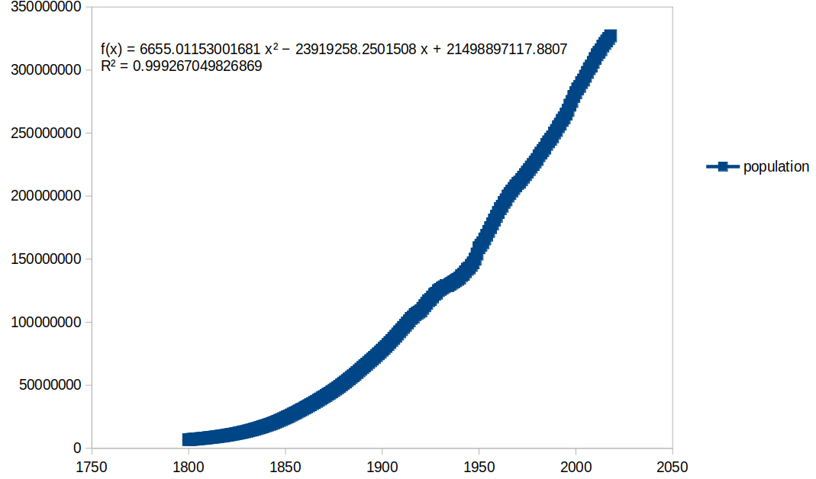
Population vs Year
With R² = 0.99

Slide 7
Hence to predict CO2 values for next 10 years, we will first predict population for next 10 years. Then using those values we can predict the CO2 values with more certainty.

Slide 8
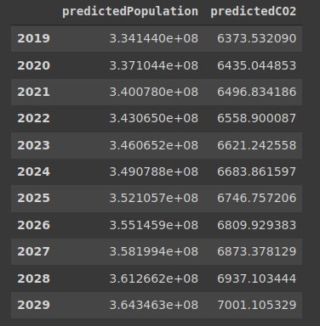
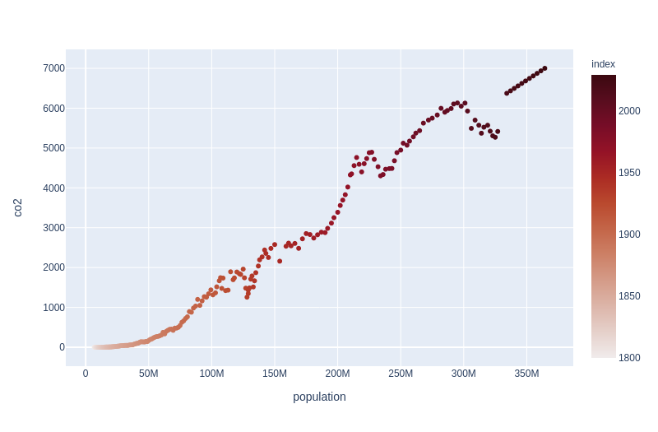
Here come the predictions!

Slide 9
The annual CO2 emissions value peaked in 2005 at 6130.552
They have been decreasing thereafter.
As we noticed in the last graph, the predicted values do not account for this drop after 2005.
Hence to forecast the values with more certainty, we should consider the values only from 1982, and not before.
Because from 1982 to 2005, it is more or less a steady growth. And after after 2005, it is steadily decreasing, as mentioned before.

Slide 10
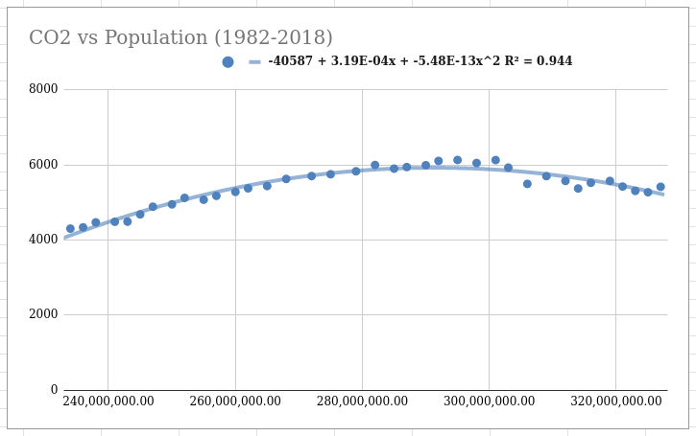
Second degree polynomial curve

Slide 11
With the R² = 0.944, we can say that it’s a good fit.
Hence we will make use of this equation to forecast the CO2 values for next 10 years.

